Slide 1
Word Senses and WordNet
CIS 530
Chris Callison-Burch

Slide 2
“I bought a new mouse.”

Slide 3
What kind of mouse
were you thinking about?

Slide 4
Word meanings are often ambiguous!

Slide 5
These two possible definitions are are known
as word senses:
noun – a piece of computer equipment
noun – a small rodent

Slide 6
Word Sense
Definition: a discrete representation of one aspect of the meaning of a given word
But how do we define word senses?

Slide 7
How many senses does a word have?
Counting the amount of senses that a word has is hard
Certain tasks exist to determine if two senses are distinct:
Zeugma: conjoining two uses of a word in a single sentence
1. Which of those flights serve breakfast?
2. Does Air France serve Philadelphia?
3. (?) Does Air France serve breakfast and Philadelphia?

Slide 8
Glosses
Definition: a human-interpretable definition of one aspect of the meaning of a given word, similar to a thesaurus entry.
Consider a bank:
noun – a financial institution
noun – a sloping part of land

Slide 9
Problems with Glosses
Often circular in definitions
Example: (red is the colour of blood) and (blood is a red liquid)
Informal (lack of structure)
Natural language representation (hard to parse)
Glosses alone aren’t sufficient for word sense understanding!

Slide 10
Sense Relationships
Word senses exhibit semantic relationships with each other
Similar to concepts in a Mind-Map
Some well-known ones are synonyms and antonyms
We can express these relationships as a graph
Nodes are words and edges are labeled sense relationships

Slide 11
Synonyms/Antonyms
Synonymy: relationship where two senses mean the same thing
e.g. plane, vehicle
Antonymy: relationship where two senses mean opposite things
e.g. rise, fall

Slide 12
Taxonomic Relationships
Hyponym: relationship where one sense is a more specific example than the second sense
e.g. potato, vegetable
Hypernym: relationship where one sense is a more general example of another
e.g. animal, koala

Slide 13
Meronymy
Relationship that exhibits a part-whole behavior
Meronym is the whole, where a holonym is the part
Example: (leg, human) or (wheel, car)

Slide 14
Structured Polysemy
Polysemous: adj. having many possible senses
Metonymy: using aspects of one concepts to refer to aspects of another
“I love the Beatles!” == “I love the Beatle’s music!”
ARTIST ←→ WORKS OF ARTIST
“The White House is incompetent.” == “The Administration is incompetent”.
BUILDING ←→ ORGANIZATION

Slide 15
What’s a good resource to capture
these word senses and relationships?

Slide 16
Introducing:
WordNet (Fellbaum, 1998)

Slide 17
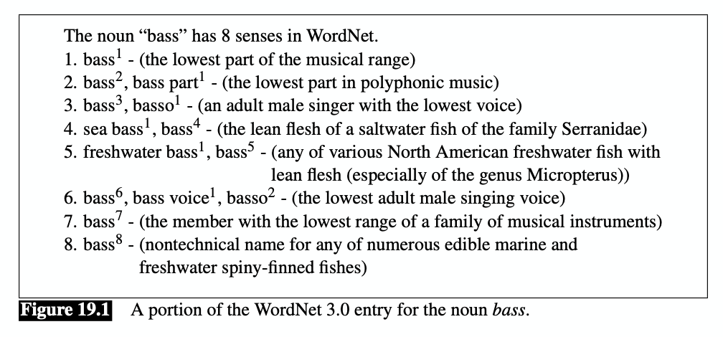
WordNet (1998)
A database of lexical relations
Three parts: nouns, verbs, and adjective/adverbs

Slide 18
WordNet (1998)
WordNet 3.0 contains 117k nouns, 11k verbs, and 26k adjectives/adverbs
The average noun has 1.23 senses, and the average verb has 2.16 senses

Slide 19
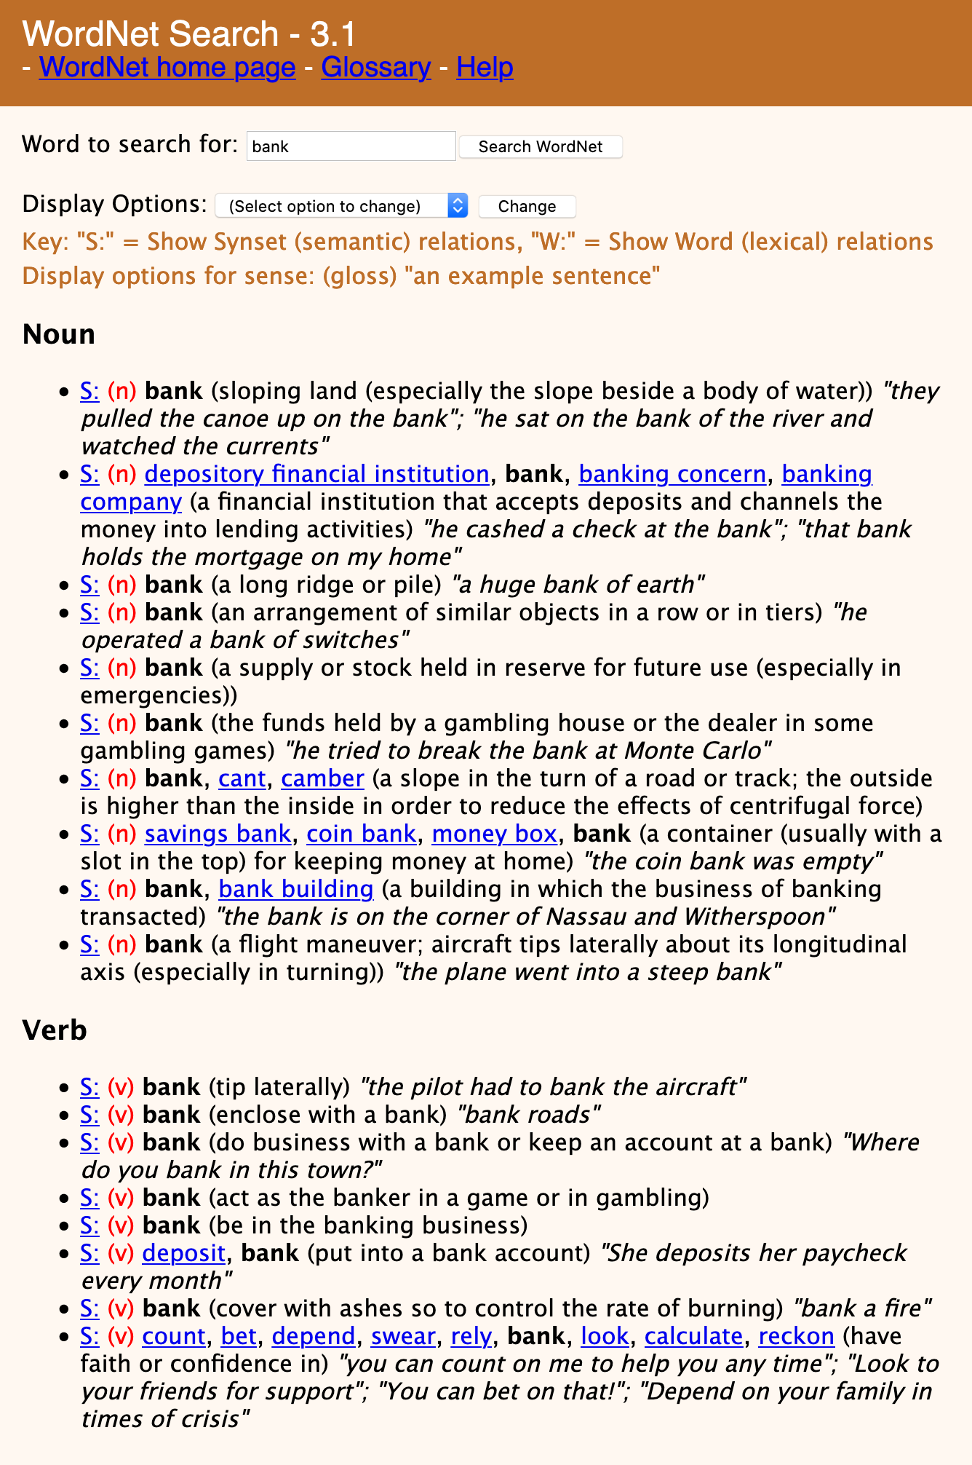
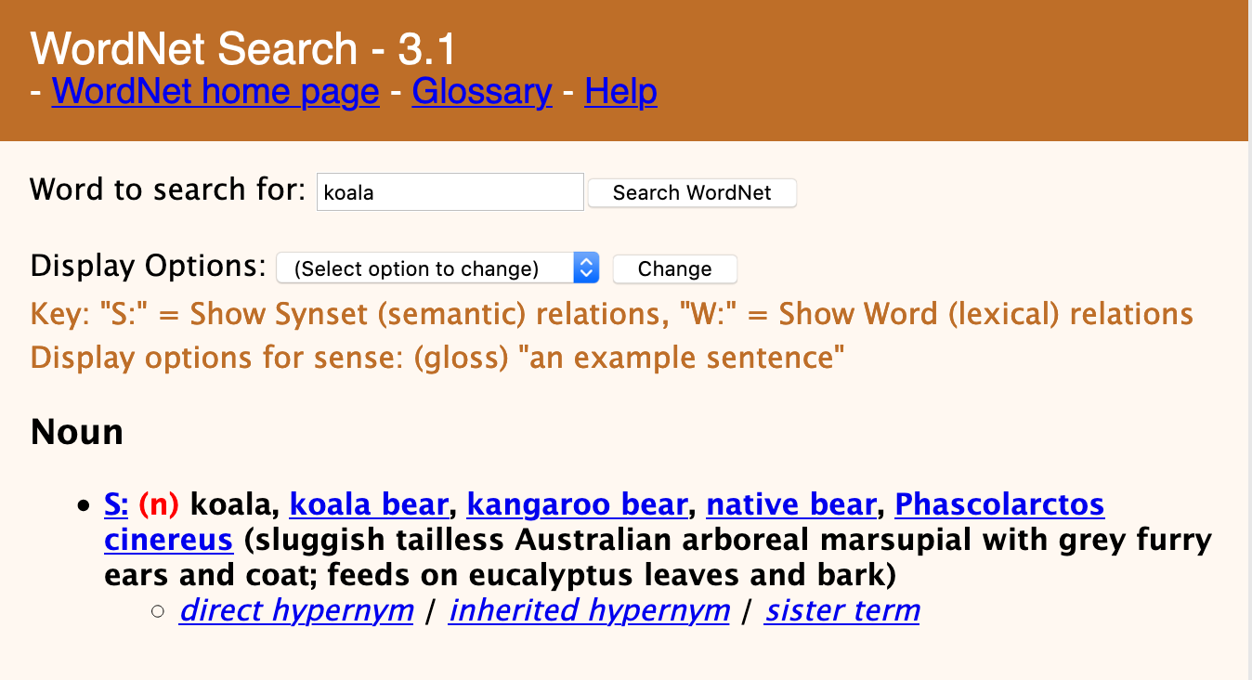

Slide 20
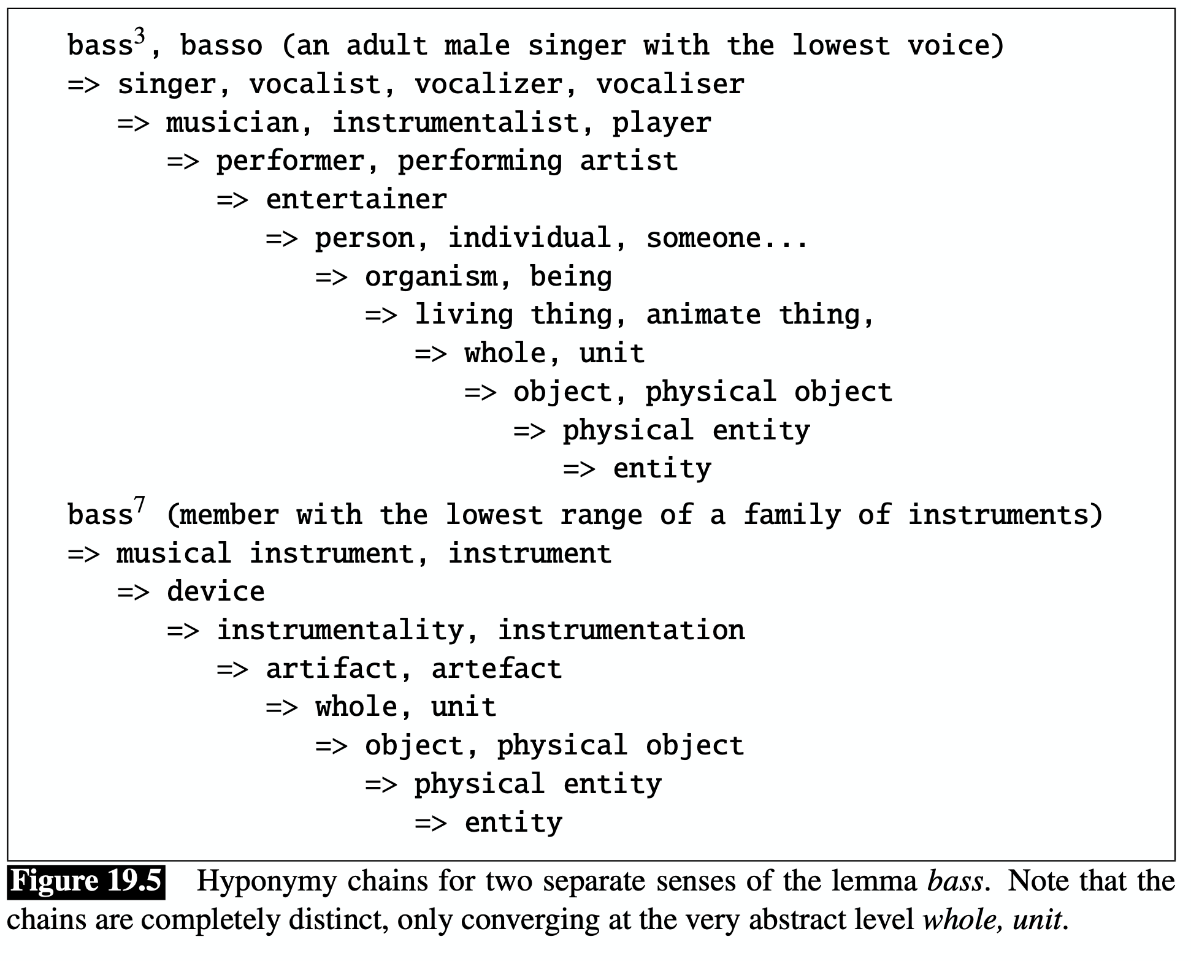

Slide 21
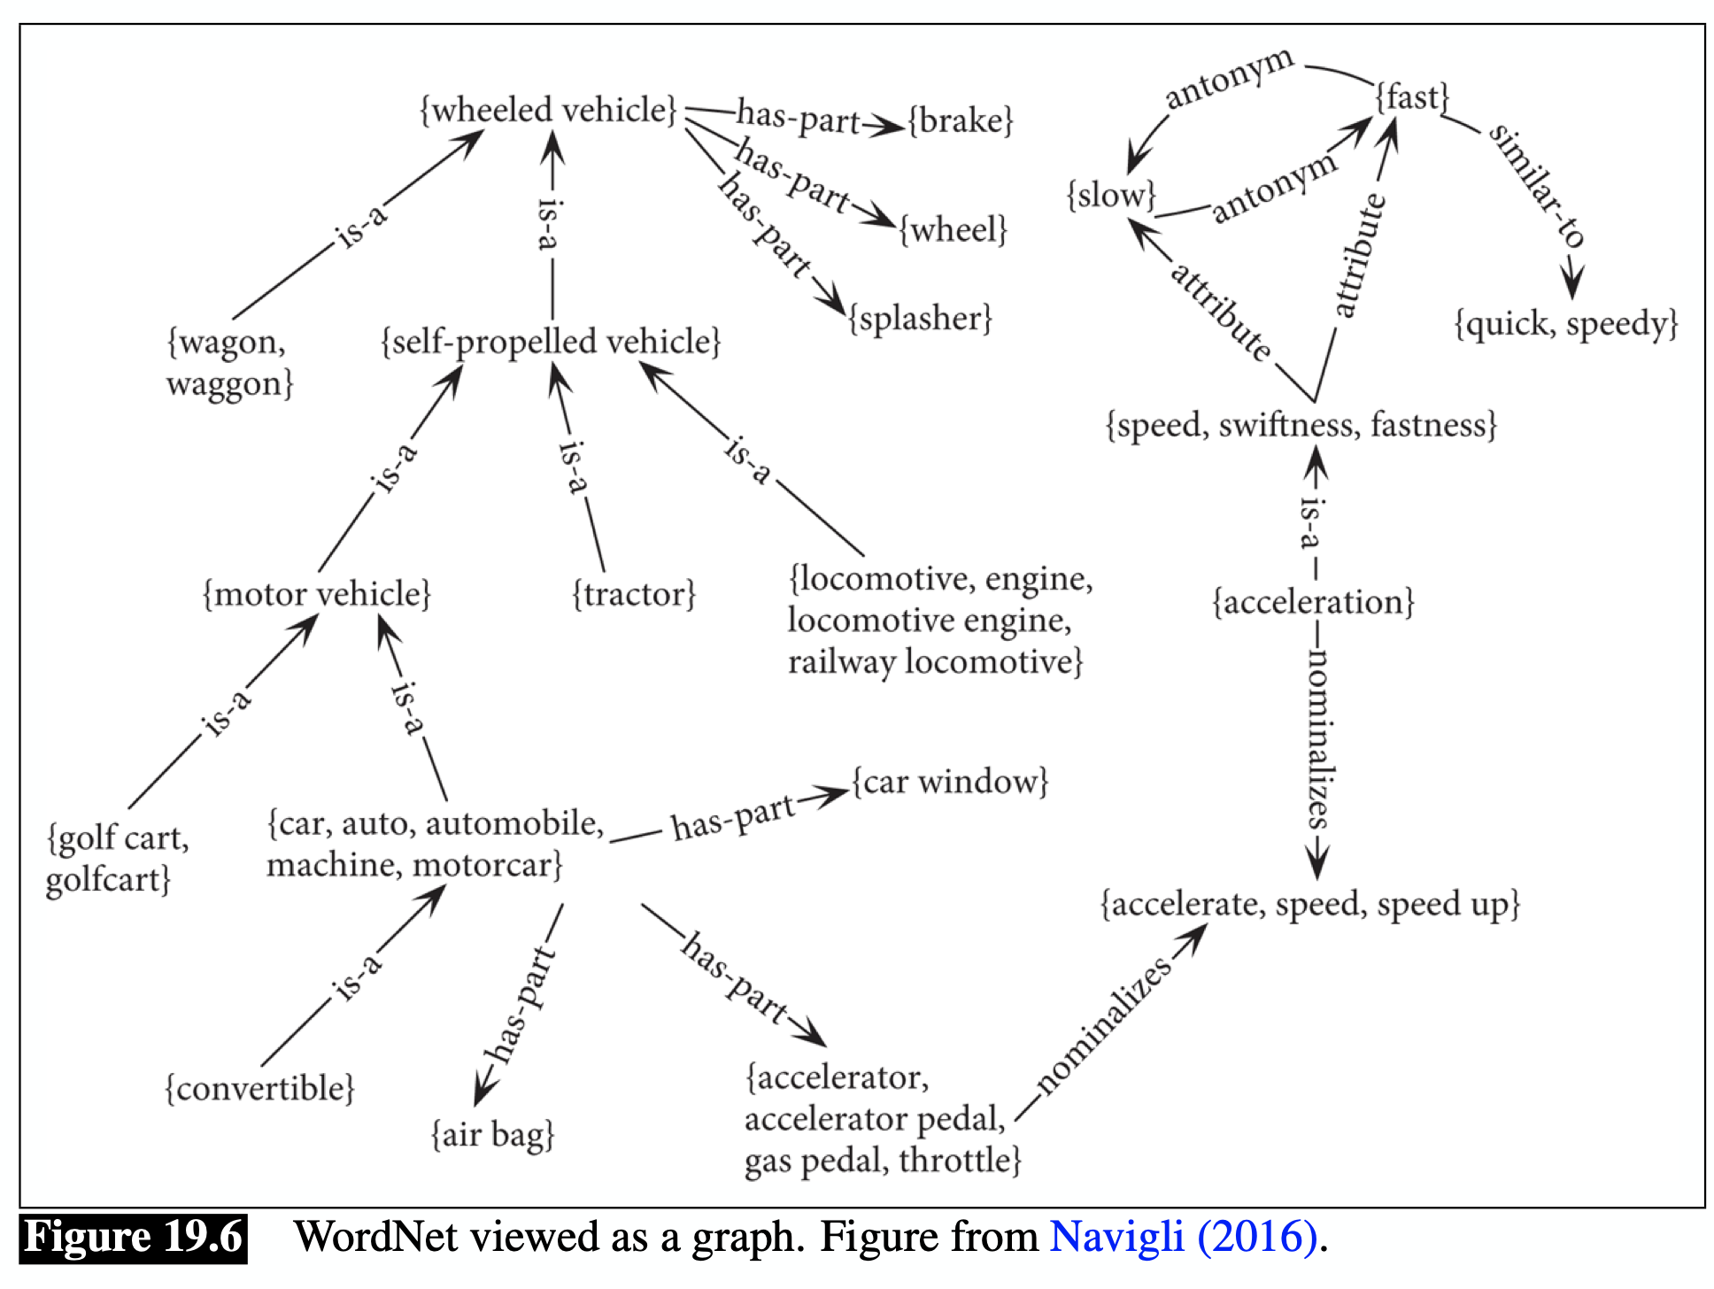

Slide 22
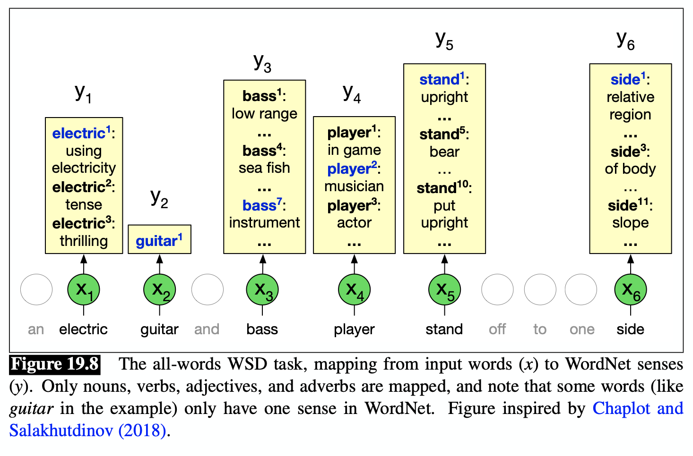
Word Sense Disambiguation
The task of selecting the correct word sense in context
Classification task over the possible senses for a given word

Slide 23
WSD Formulations
Lexical Sampling Task
Given an input text and a target set of words, classify the word sense for each word in the target set.
All Words Task
Given an input text, classify the word sense for every word in the text.

Slide 24
WSD Supervised Learning
Training Data: Semantic Concordance
A corpus where every content word is labeled with its word sense from a specific resource (e.g. thesaurus, WordNet).
What kinds of models can we train with this dataset?

Slide 25
WSD Baseline
Most Frequent Baseline
For every word, select the word sense that appears most often (in WordNet, this is the first sense since senses are sorted by prior probability).

Slide 26
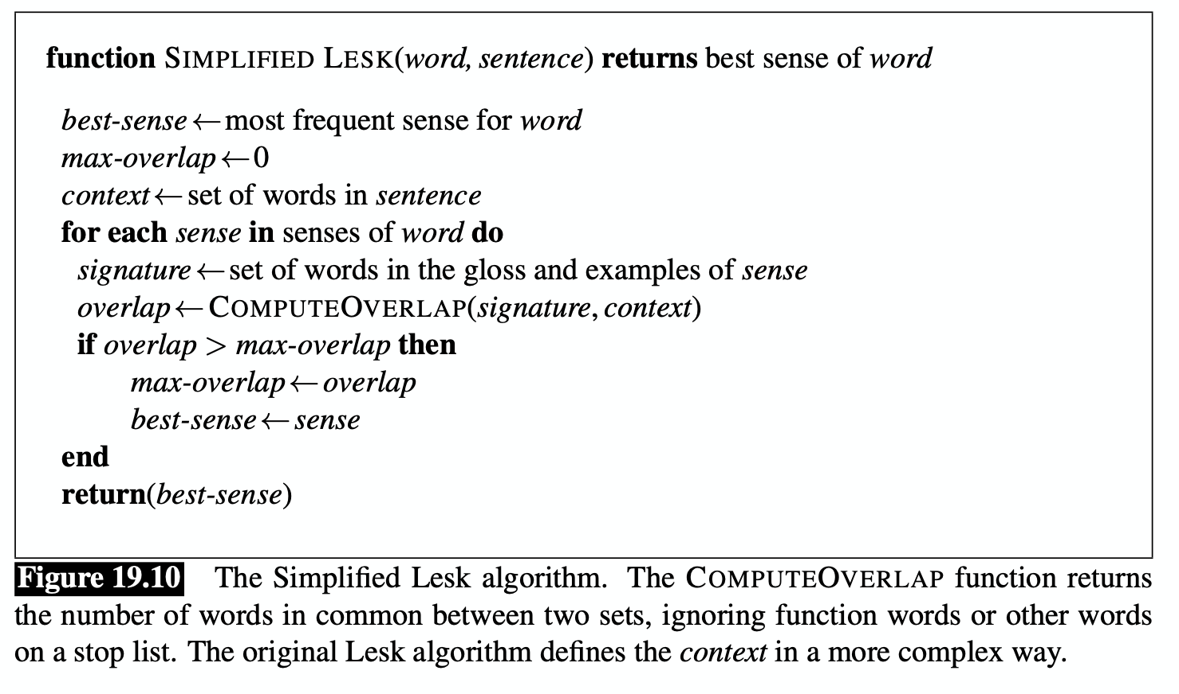
Lesk Algorithm as a WSD Baseline
Simplified Lesk Algorithm Idea: select the sense with the most overlapping tokens with the context.

Slide 27
State of the Art in WSD
Recall: Contextualized Embeddings
A dense/continuous vector representation of words, contextualized by its sentence’s context, outputted by models such as BERT or ELMO.
Why does this help?

Slide 28
State of the Art in WSD
Algorithm: 1-Nearest Neighbour
Create an embedding for each word sense by averaging the contextual embeddings of the words in the sense’s gloss. This creates a sense embedding.
We can classify senses by taking the contextualized embedding for the target word and selecting the sense with the closest embedding (e.g. using cosine distance).

Slide 29
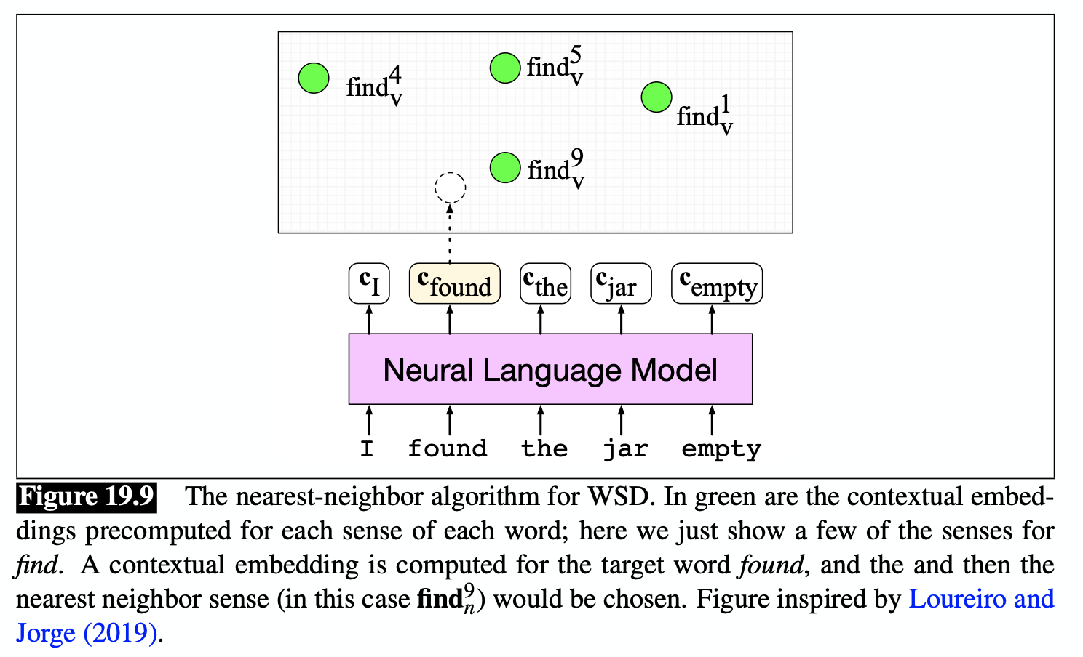

Slide 30
What about words that are out of vocabulary?
Can we do better than the baseline?
How can we leverage contextualized embeddings and sense relationships to perform WSD?

Slide 31
Loureiro and Jorge (2019)
Idea: approximate missing embeddings bottom-up using sense relations
Define embeddings in accordance with graph taxonomy:
Higher-level node as the averaged embedding of its children.
Sysnet (synonym set) as the average of its sense embeddings.
Hypernym as the average of its synset embeddings.
Lexicographic category (supersense) embedding as the average of the large set of synset embeddings with that category.

Slide 32
Labeling a corpus of word senses is difficult and involves a lot of human annotation.
How can we learn word senses directly from the training set in an unsupervised manner?

Slide 33
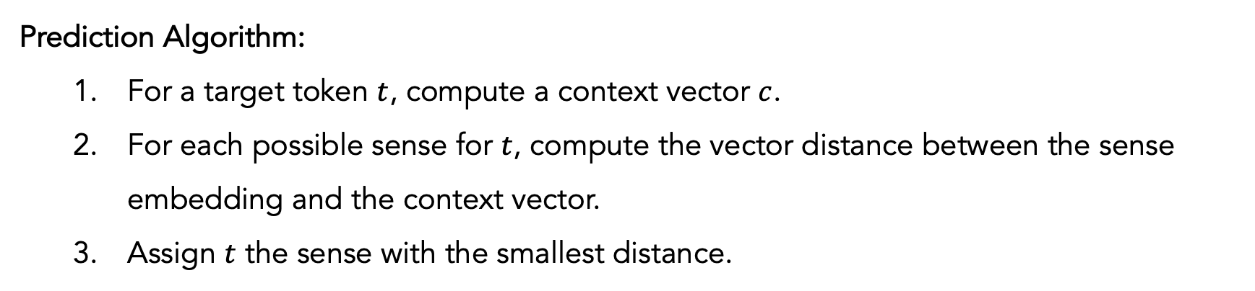
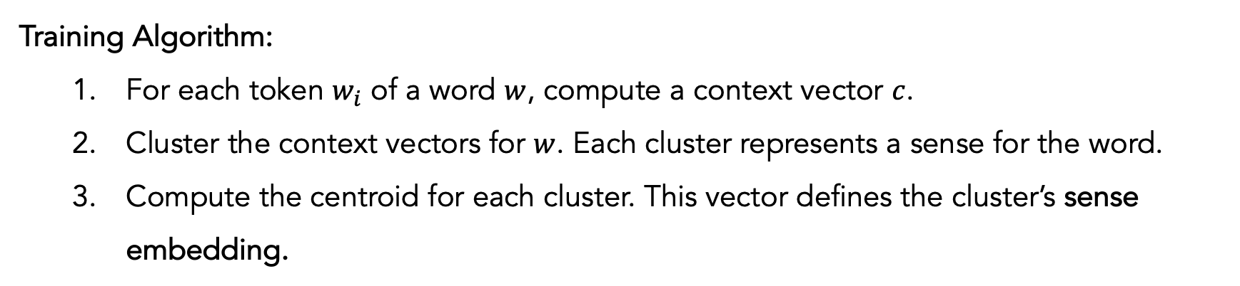
Word Sense Induction (Schütze 1992)
Training Algorithm:
For each token $w_{i}$ of a word $w$, compute a context vector $c$.
Cluster the context vectors for $w$. Each cluster represents a sense for the word.
Compute the centroid for each cluster. This vector defines the cluster’s sense embedding.
Prediction Algorithm:
For a target token $t$, compute a context vector $c$.
For each possible sense for $t$, compute the vector distance between the sense embedding and the context vector.
Assign $t$ the sense with the smallest distance.

